Slide 1


1

Slide 2

TALLA PADMAVATHI COLLEGE OF ENGINEERING
Approved by ACITE New Delhi-affiliated to JNTU Hyderabad NAAC Accredited-AM ISO 9001-2015 Certified Institution
SOMIDI,KAZIPET,WARANGAL .
Department of Computer Science & Engineering
A Major Project Stage-II Presentation
ON
HUMAN STRESS DETECTION BASED ON SLEEPING HABITS USING MACHINE LEARNING
BATCH-09
UNDER THE GUIDANCE OF
Mr. E. Ajith Kumar
TPO & Assistant Professor
Department of CSE.
TEAM MEMBERS
MD.SALMA BEGAM - 21UC1A0546
T.ARAVINDA SWAMY - 21UC1A0568
G.POOJITHA - 21UC1A0525
G.SHASHANK - 21UC1A0524
2

Slide 3
CONTENTS
Abstract
Introduction
Literature survey
System analysis
a. Existing system
b. Proposed system
Design
Modules
System Specifications
Code implementation
Result
Testing
Conclusion
Limitations
References
3

Slide 4

ABSTRACT
Human stress, often triggered by challenging environments, significantly impacts overall well-being. Our Project focuses on detecting human stress through sleep-related behaviors using machine learning and deep learning techniques. Six machine learning algorithms, including Naïve Bayes, and deep learning methods and deeper neural networks were tested. The Naïve Bayes algorithm stood out, achieving 91.27% accuracy. Our Project main objective is to investigate how human stress might be detected using machine learning algorithms based on sleep-related behaviours.
4

Slide 5
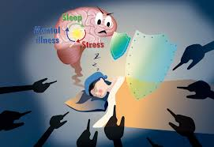
INTRODUCTION
Sleep Disruptions are often sign of a Stress.
Monitoring stress levels is crucial to reduce its adverse effects on health.
Sleep behaviors are closely linked to stress, with disruptions in sleep patterns.
Various machine learning algorithms can analyze sleep data to detect stress.
Stress detection using sleep behaviors can lead to improved stress management.
5

Slide 6

LITERATURE SURVEY
Stress and Sleep Relationship (2010 - 2015) by Van Cauter (2010), Kuhlman (2015).
Wearables for Sleep Monitoring (2015 - 2018) by Haghayegh et al. (2017).
Traditional Stress Detection Approaches (2009 - 2014) by Chida & Steptoe (2014).
Deep Learning Approaches for Sleep and Stress Analysis (2018 - 2022).
6

Slide 7
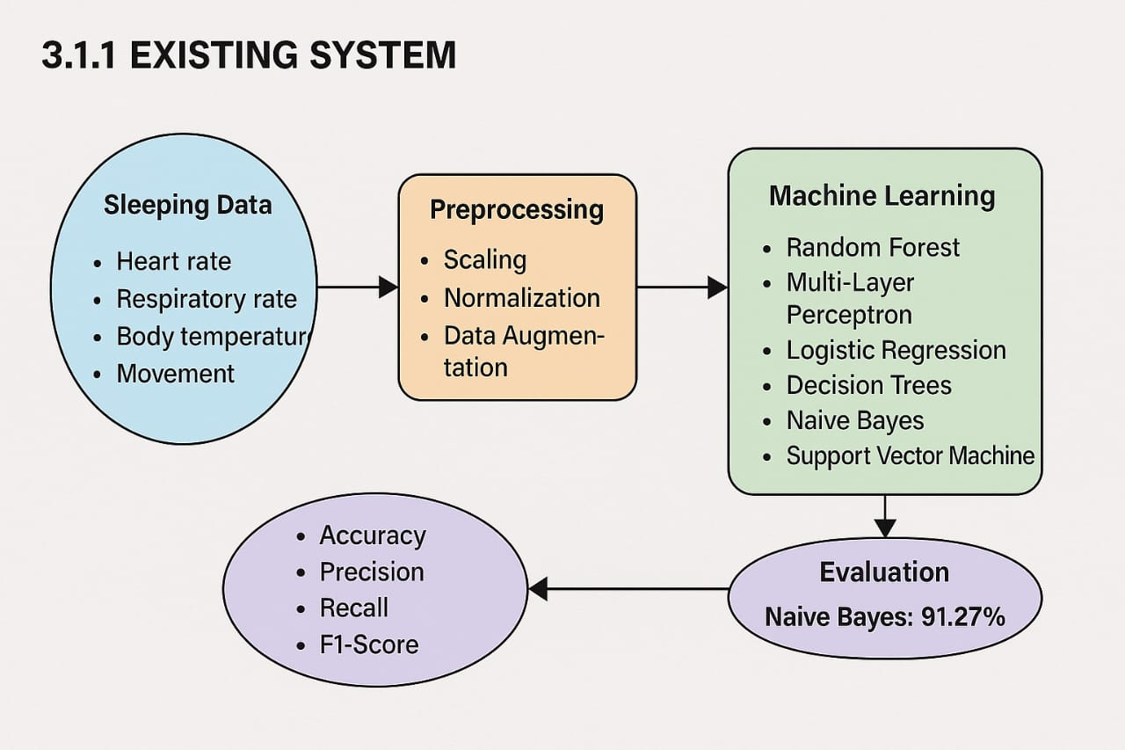
EXISTING SYSTEM
Random Forest, Logistic Regression, Decision Trees, Naive Bayes Analyse sleep related data.
Preprocessing techniques like scaling, normalization, and data augmentation improve the dataset.
Processed data is used to train stress detection models, evaluated with accuracy, precision.
Disadvantages:
Overfitting risk.
Data quality dependency.
7

Slide 8
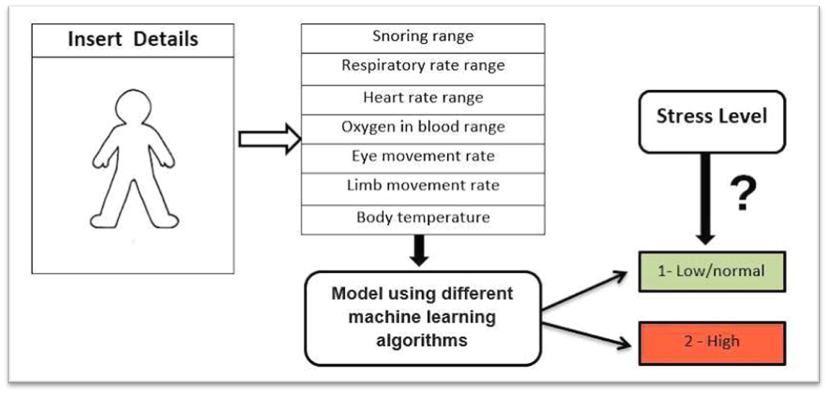
PROPOSED SYSTEM
Enhance stress detection based on sleeping habits using deep learning techniques.
Data preprocessing includes scaling, normalization to improve dataset quality.
The best model is then integrated into a web application.
The web app provides personalized stress insights based on individual sleep patterns.
Advantages:
Proactive Stress Management.
Web Application Integration.
Enhanced Model Performance.
8

Slide 9
DESIGN
To design the module in diagram Format we use UML diagrams which will make easier to understand.
Use case diagram.
Class diagram.
Activity diagram.
Sequence diagram.
Data flow diagram.
9

Slide 10
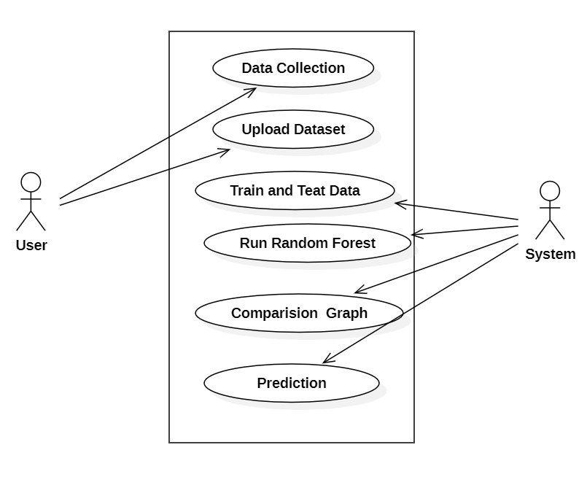
USECASE DIAGRAM
10

Slide 11
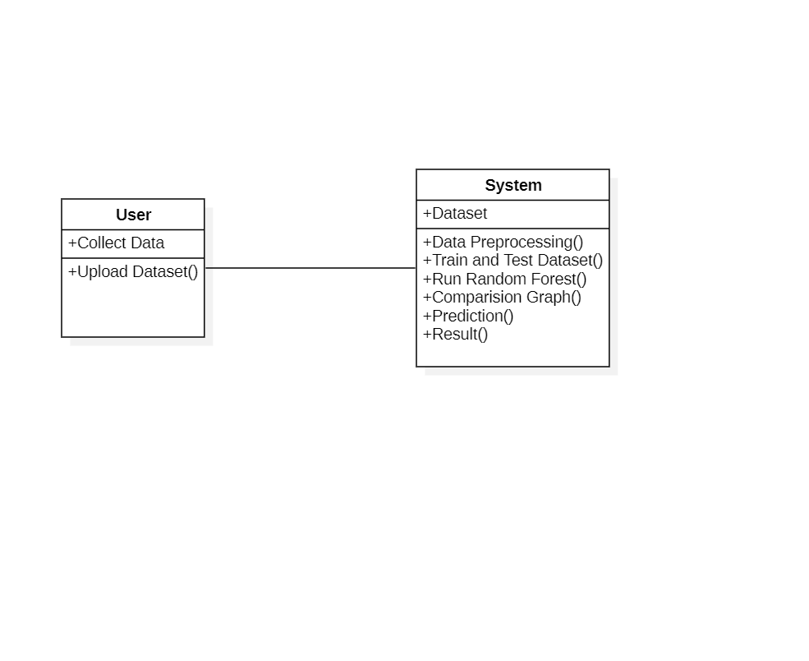
CLASS DIAGRAM
11

Slide 12
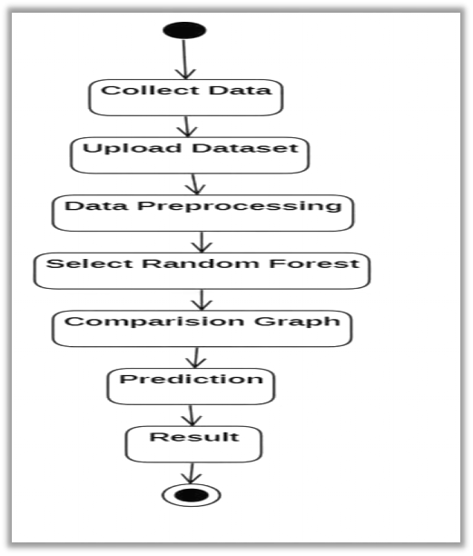
ACTIVITY DIAGRAM
12

Slide 13
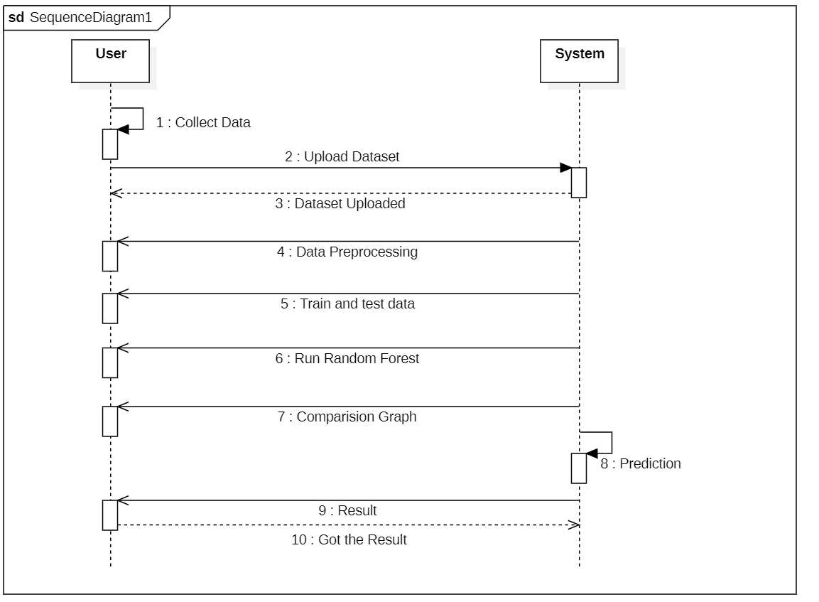
SEQUENCE DIAGRAM
13

Slide 14
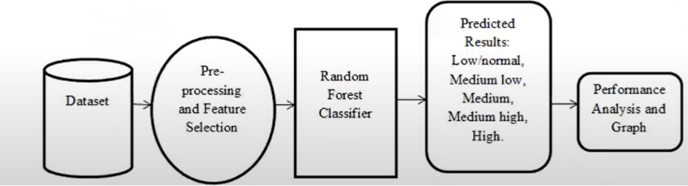
DATA FLOW DIAGRAM
14

Slide 15
MODULES
Data Collection.
Data Preprocessing.
Feature Extraction.
Machine Learning Model selection.
Training.
User Interface.
15

Slide 16
SYSTEM SPECIFICATIONS
Software Requirements
Operating System : Windows.
Coding Language : Python 3.7.
Hardware Requirements
Processor : Intel core i5.
RAM : 512 MB.
Hard Disk : 40 GB.
16

Slide 17
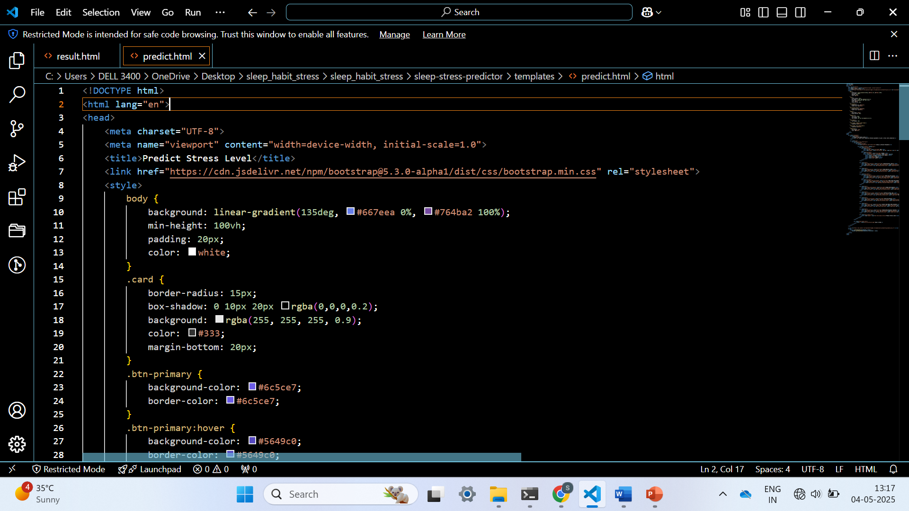
CODE FRONT-END:
17

Slide 18
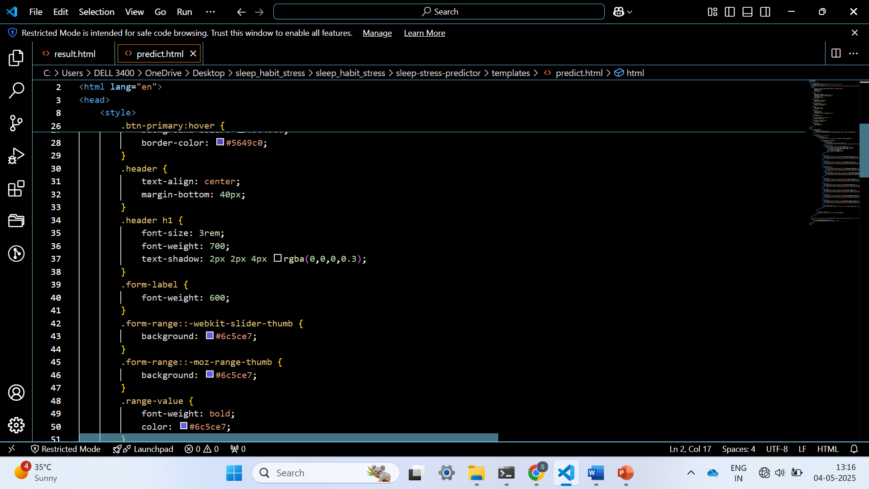
18

Slide 19
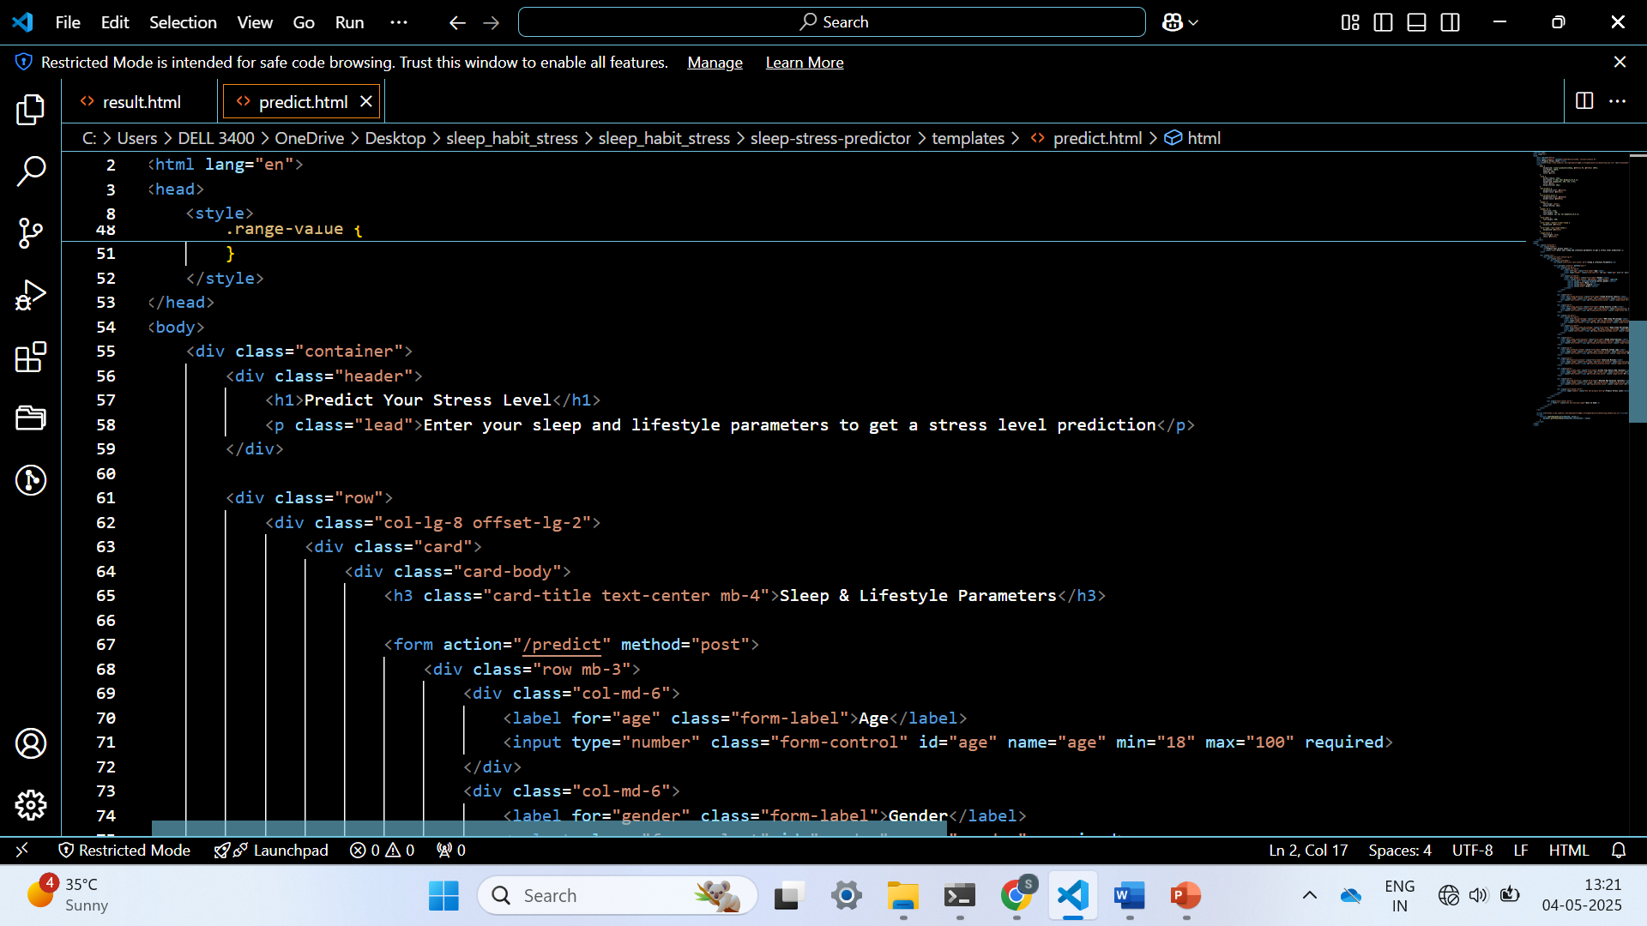
19

Slide 20
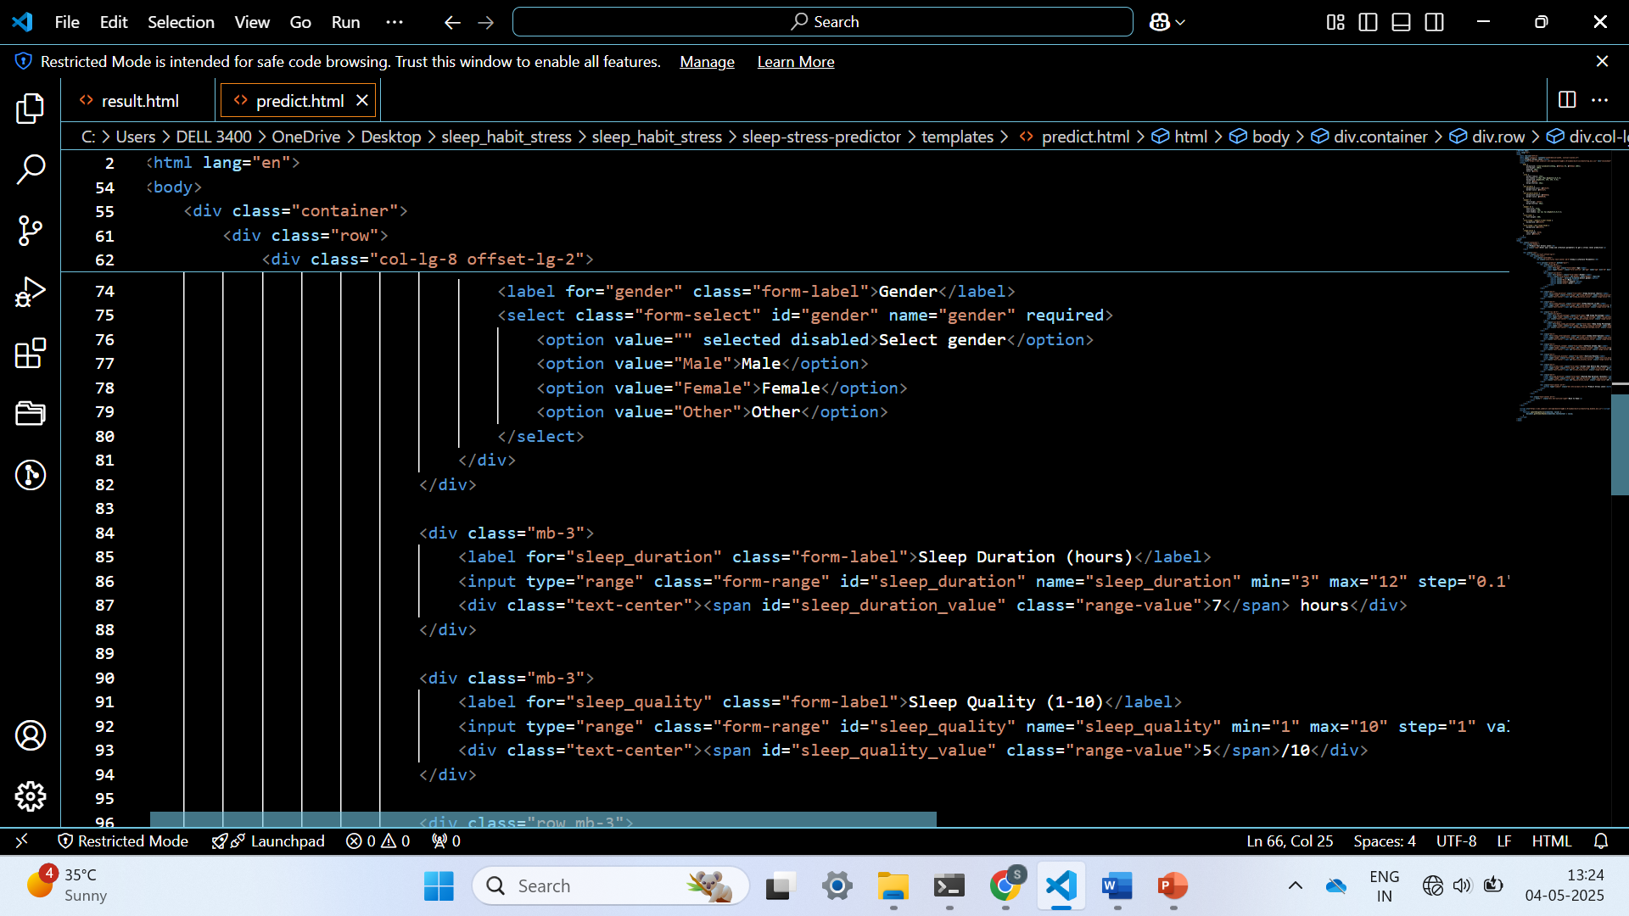
20

Slide 21
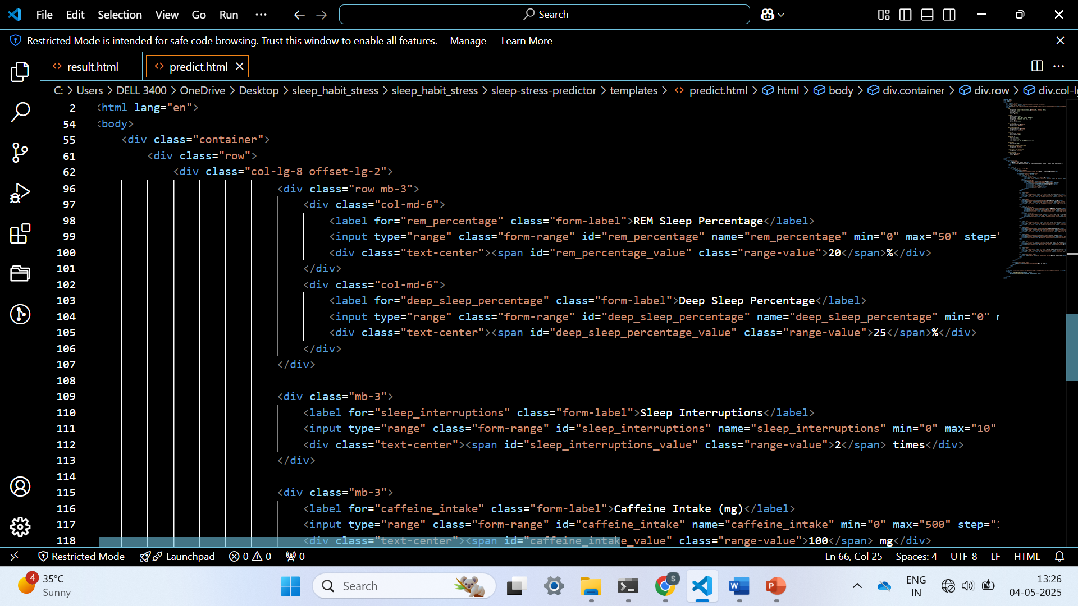
21

Slide 22
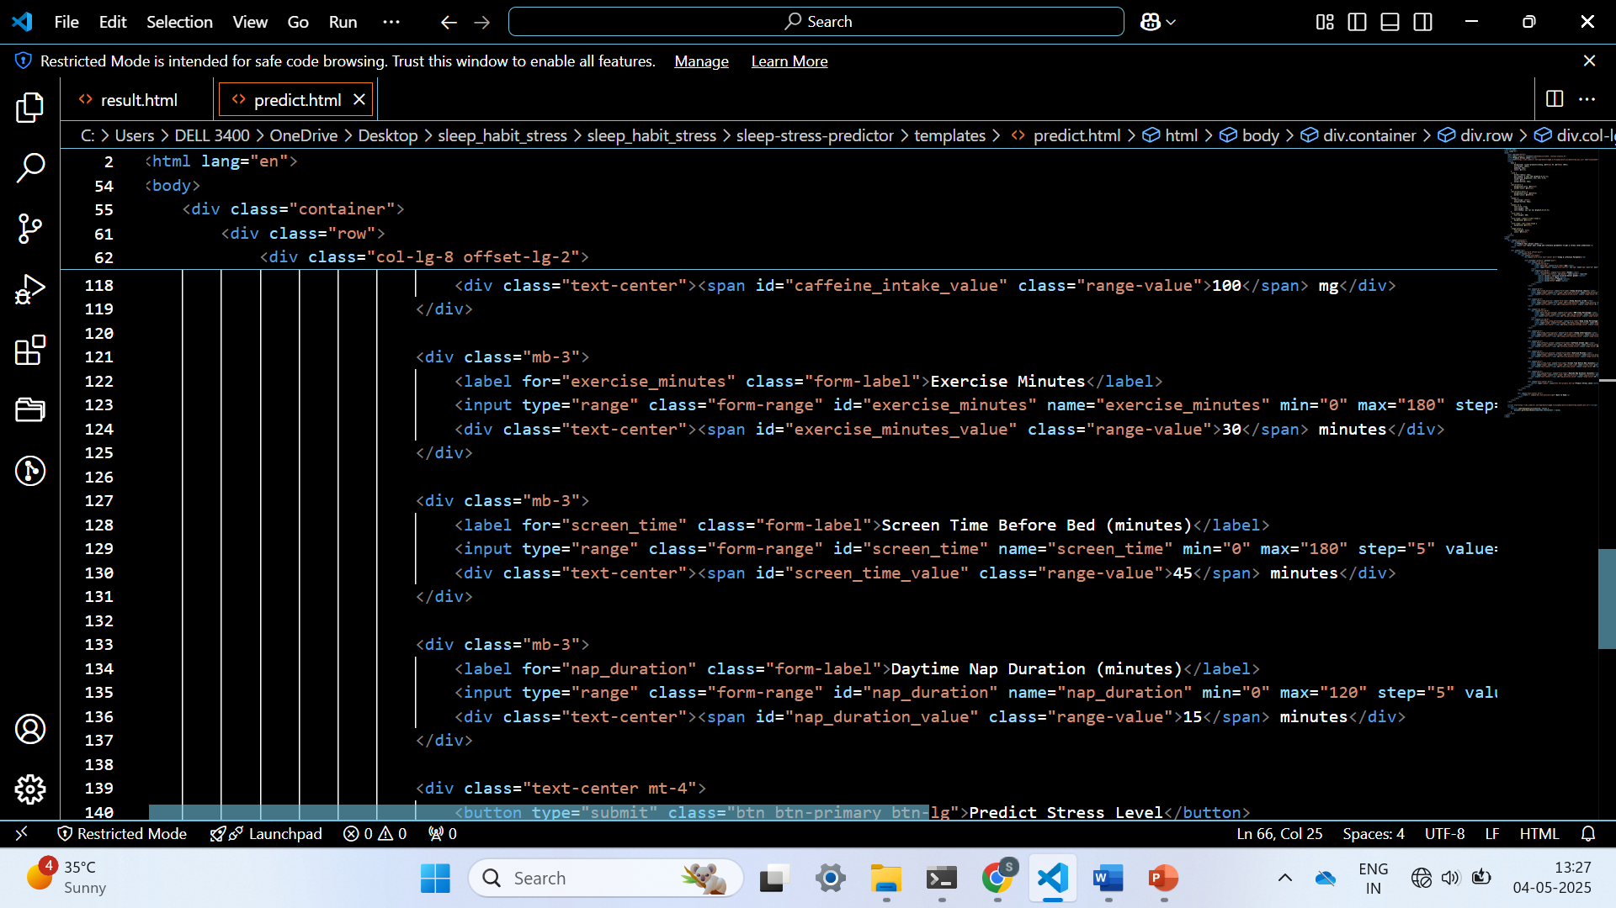
22

Slide 23
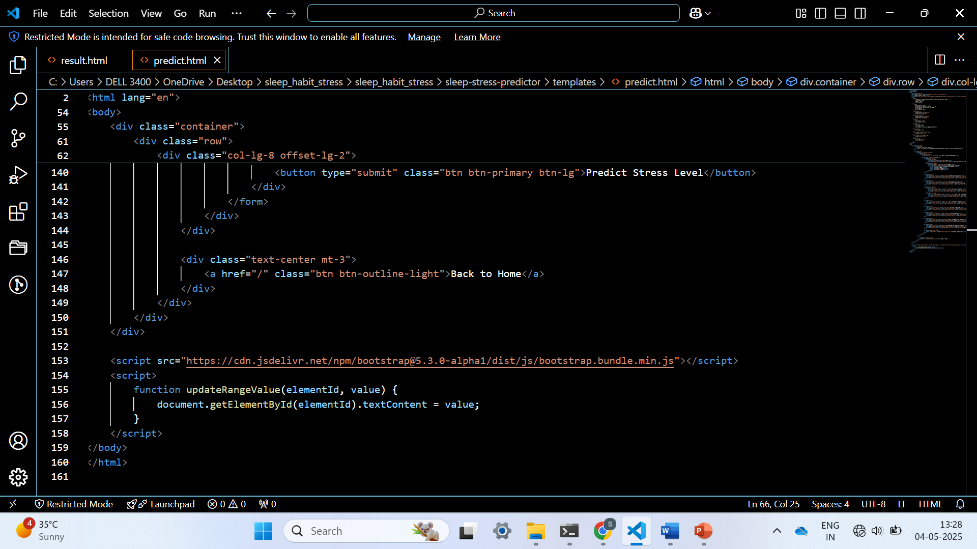
23

Slide 24
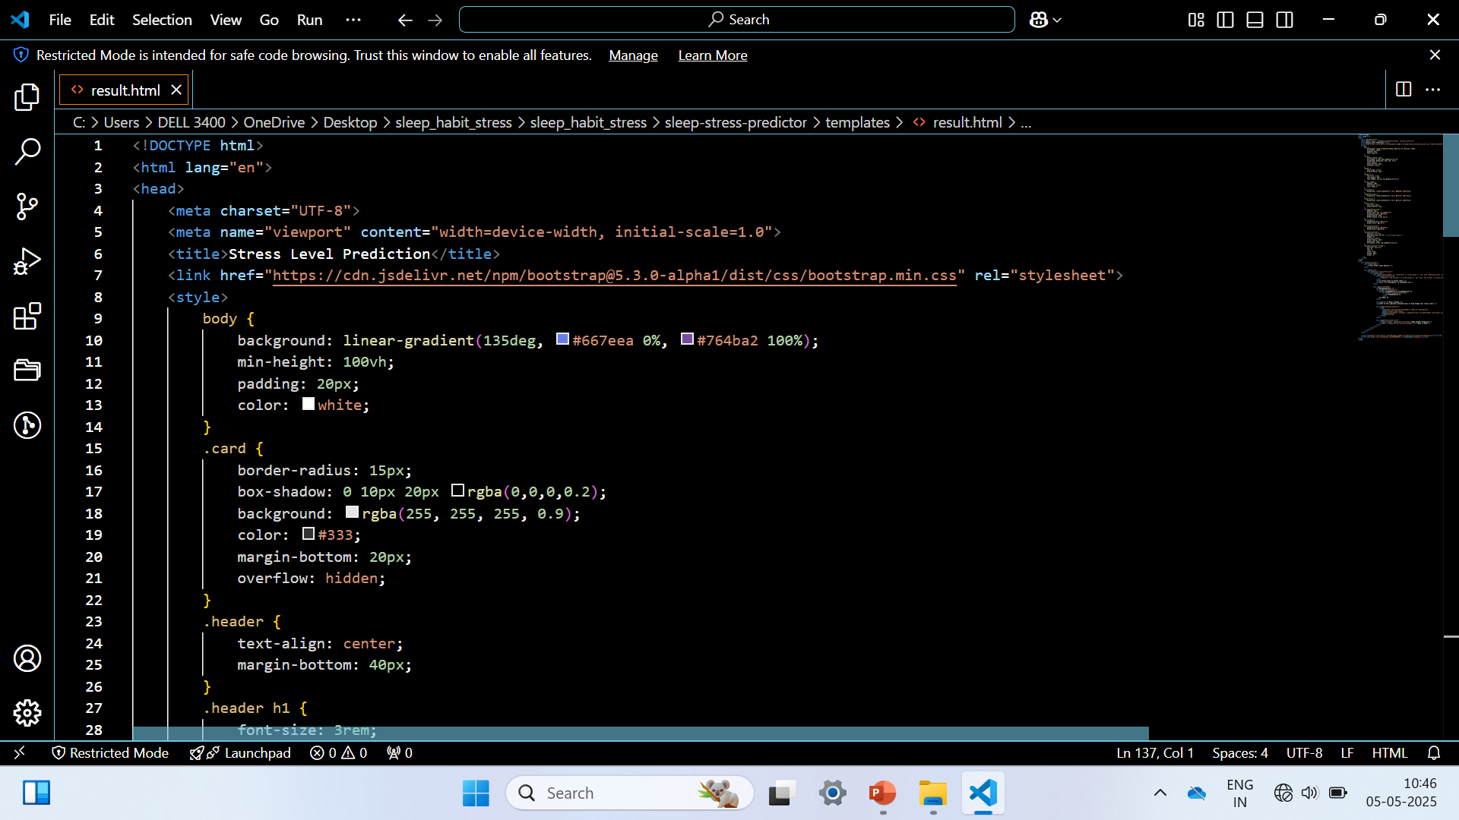
24

Slide 25
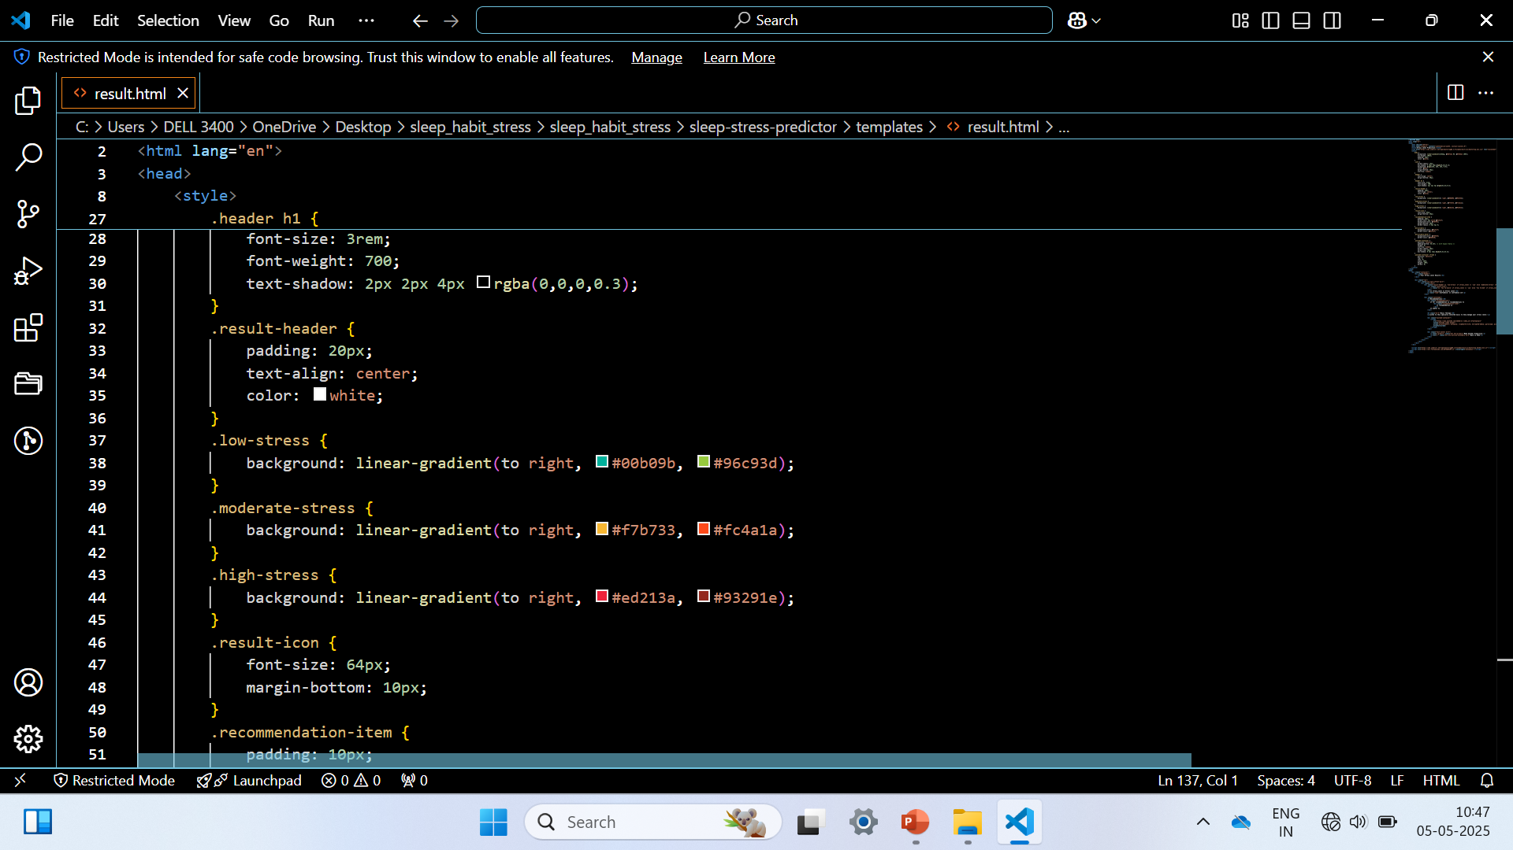
25

Slide 26
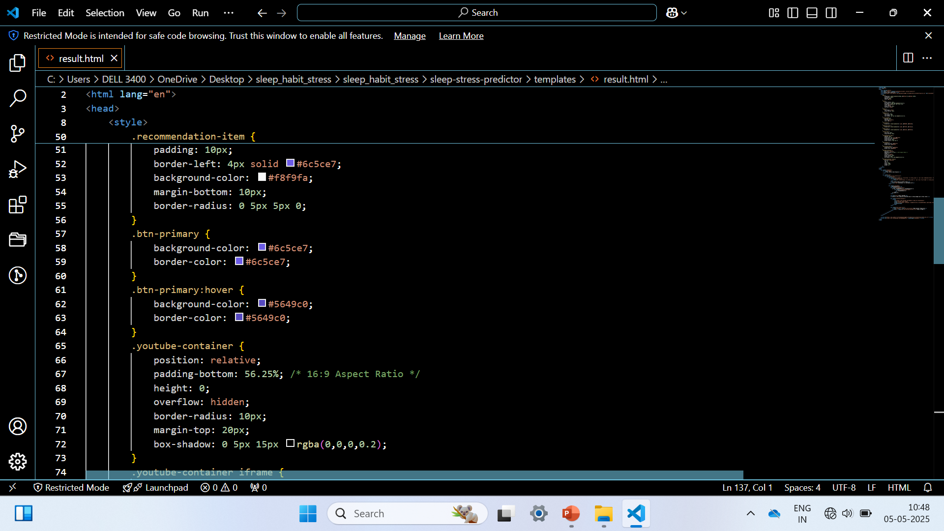
26

Slide 27
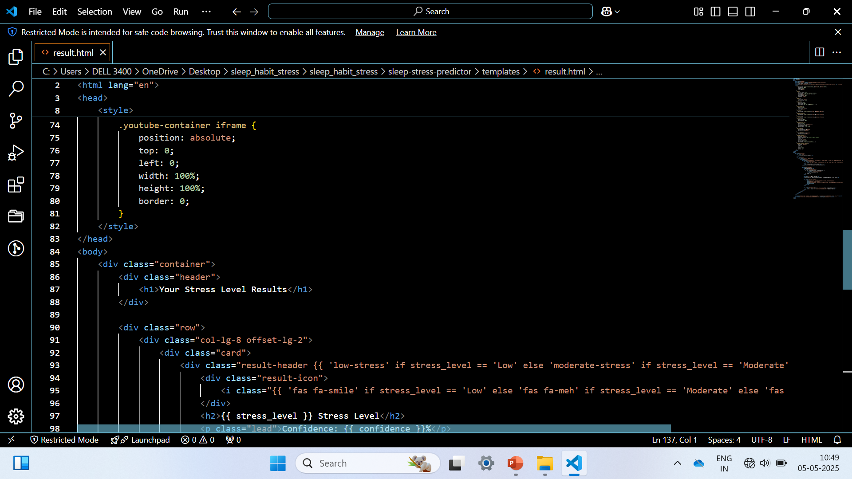
27

Slide 28
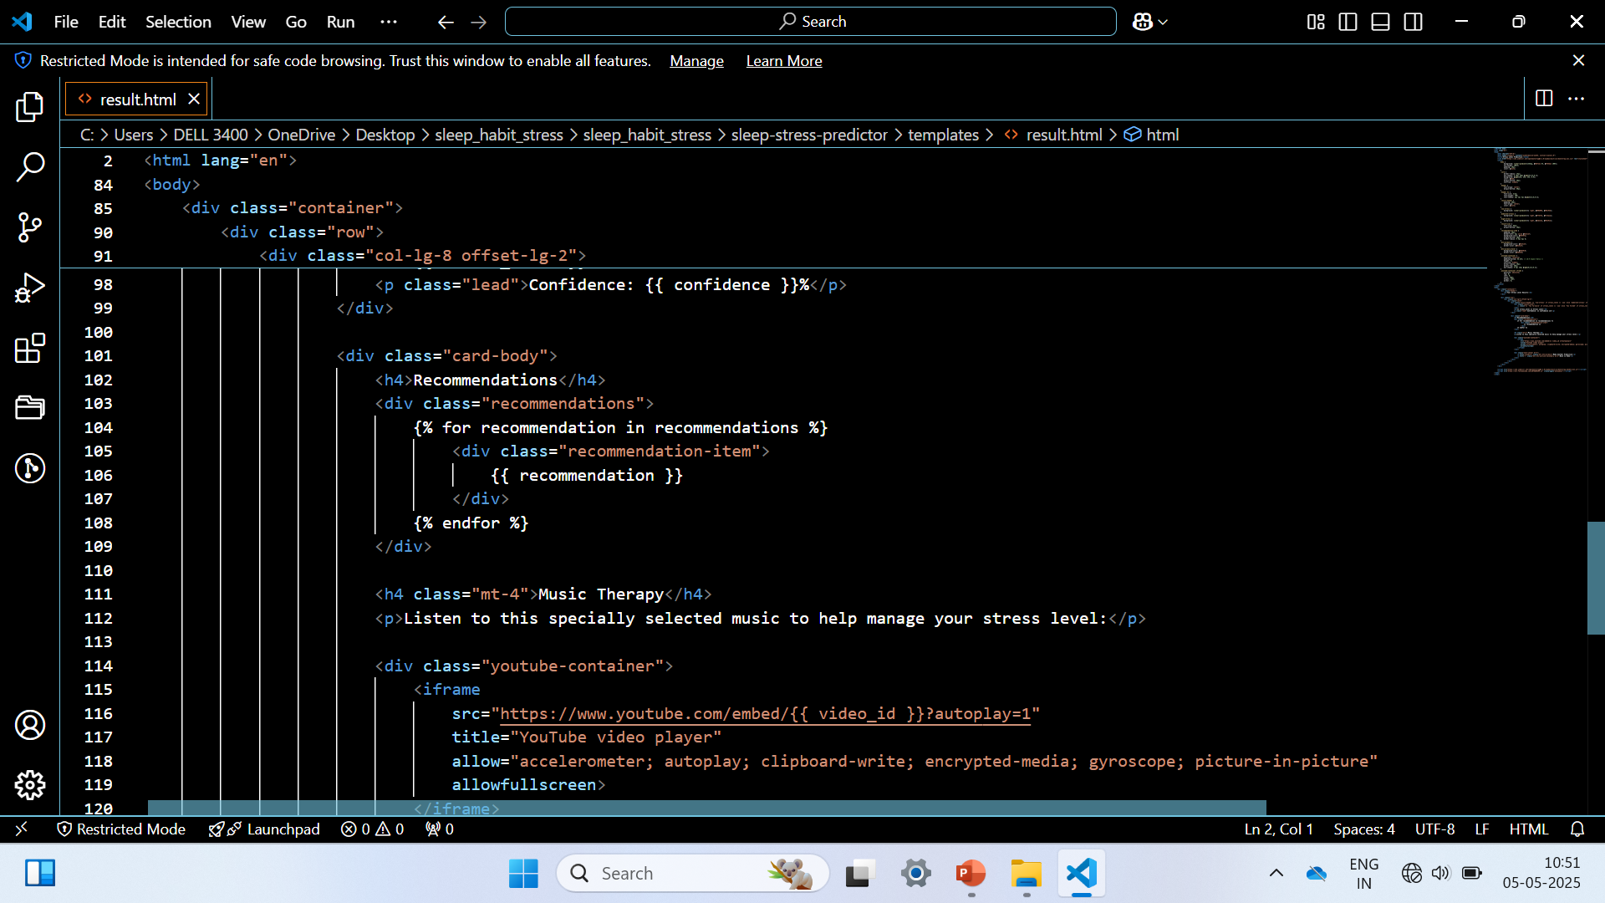
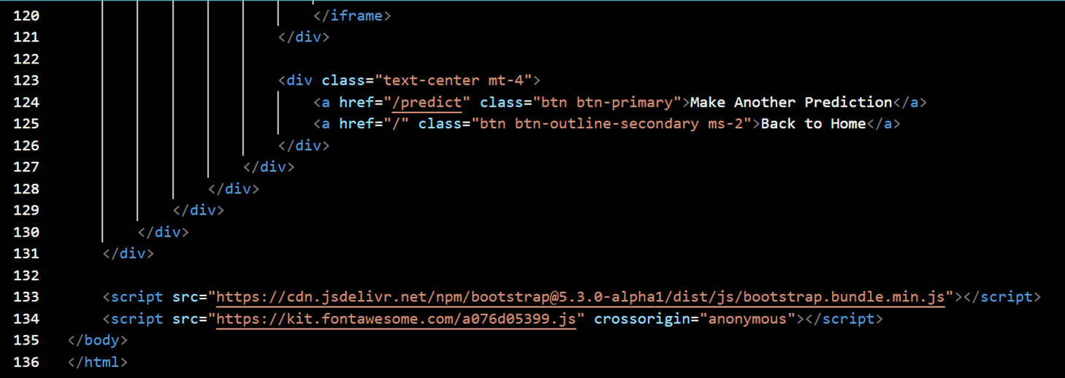
28

Slide 29
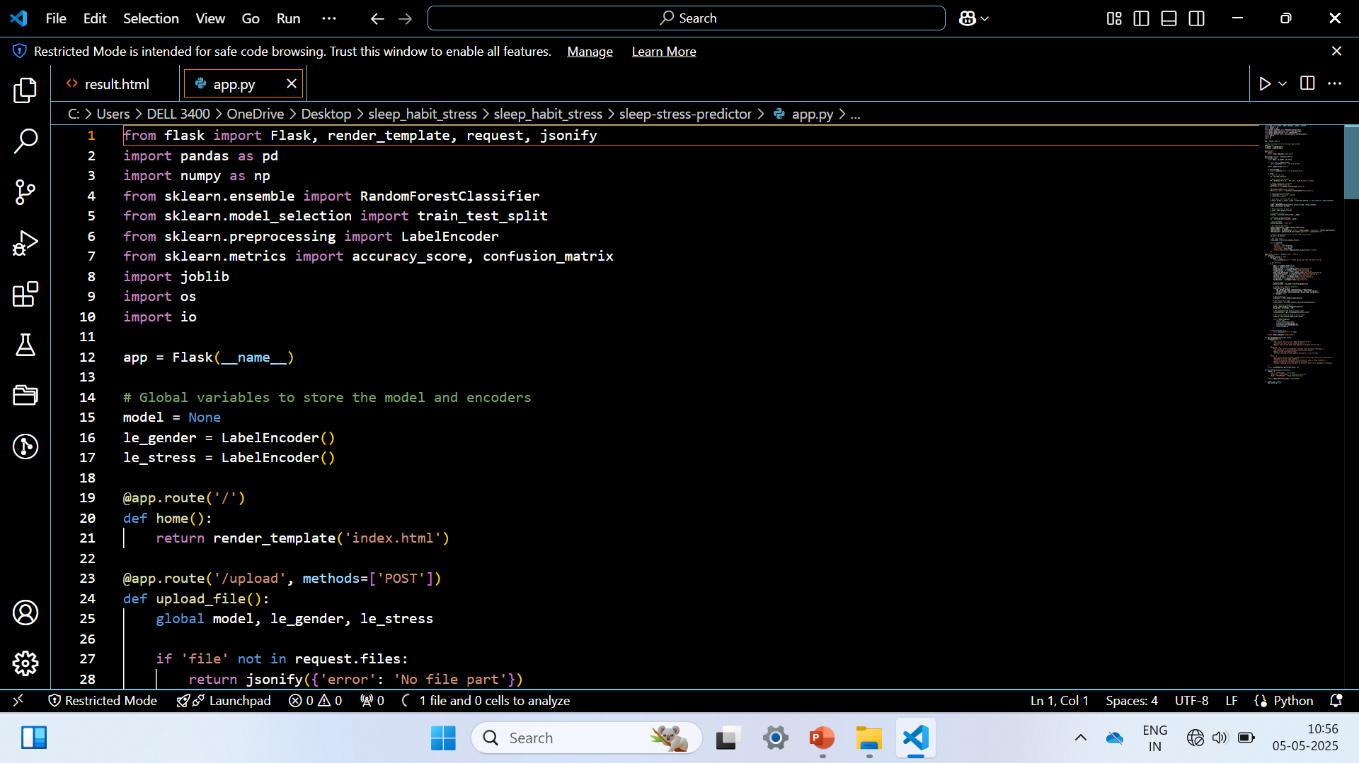
BACK-END:
29

Slide 30
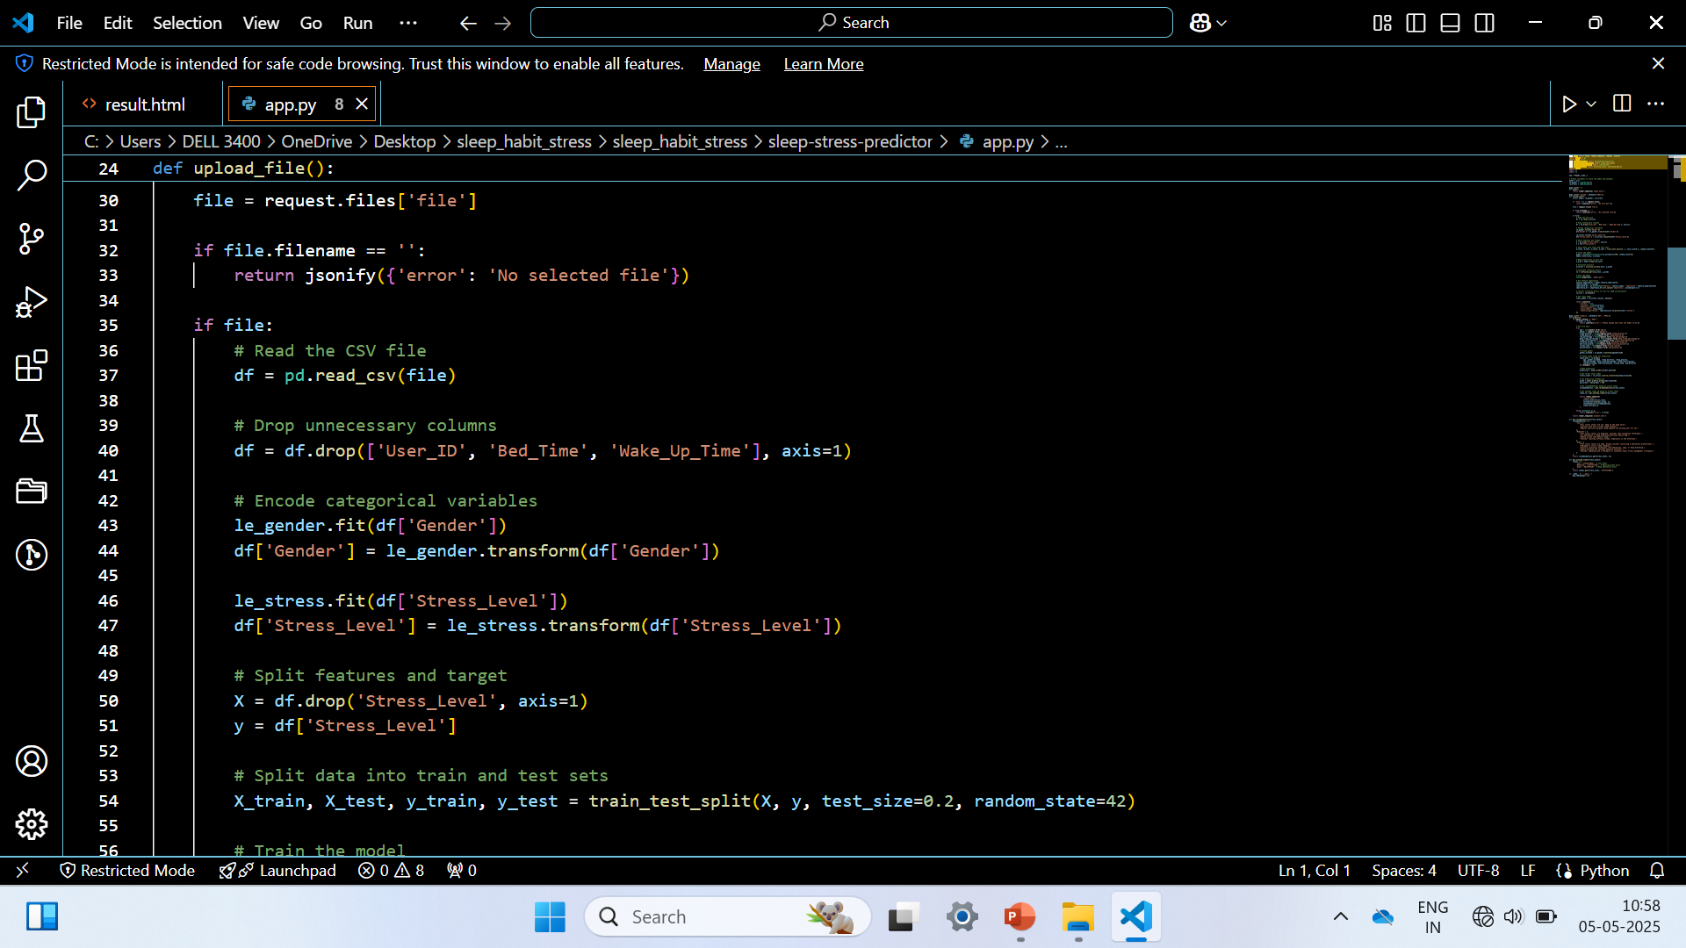
30

Slide 31
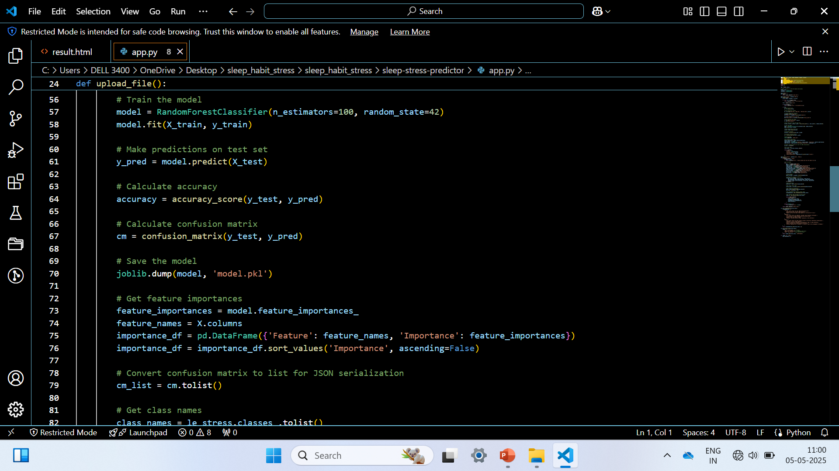
31

Slide 32
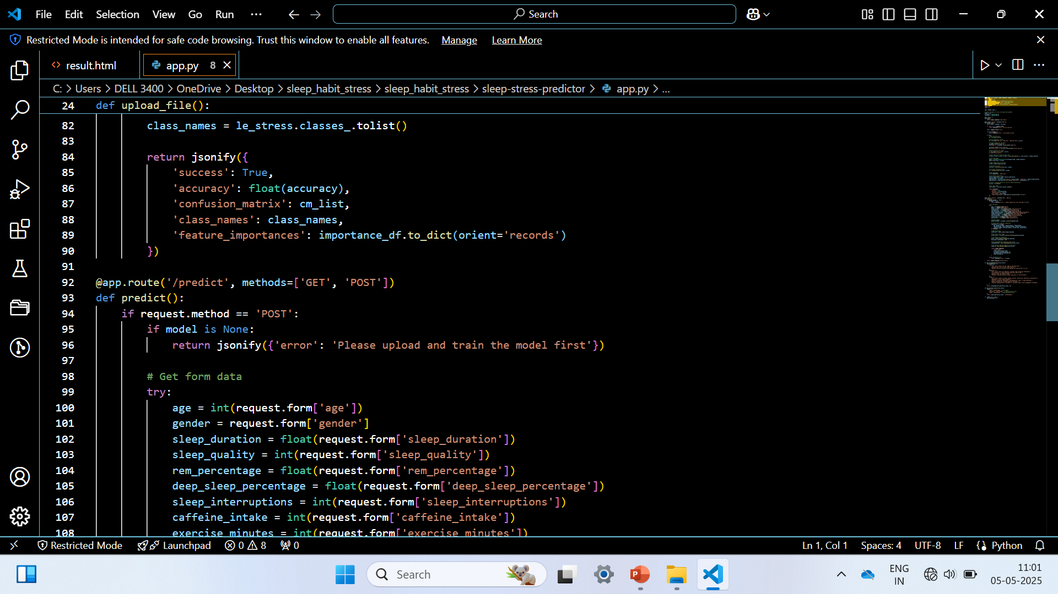
32

Slide 33
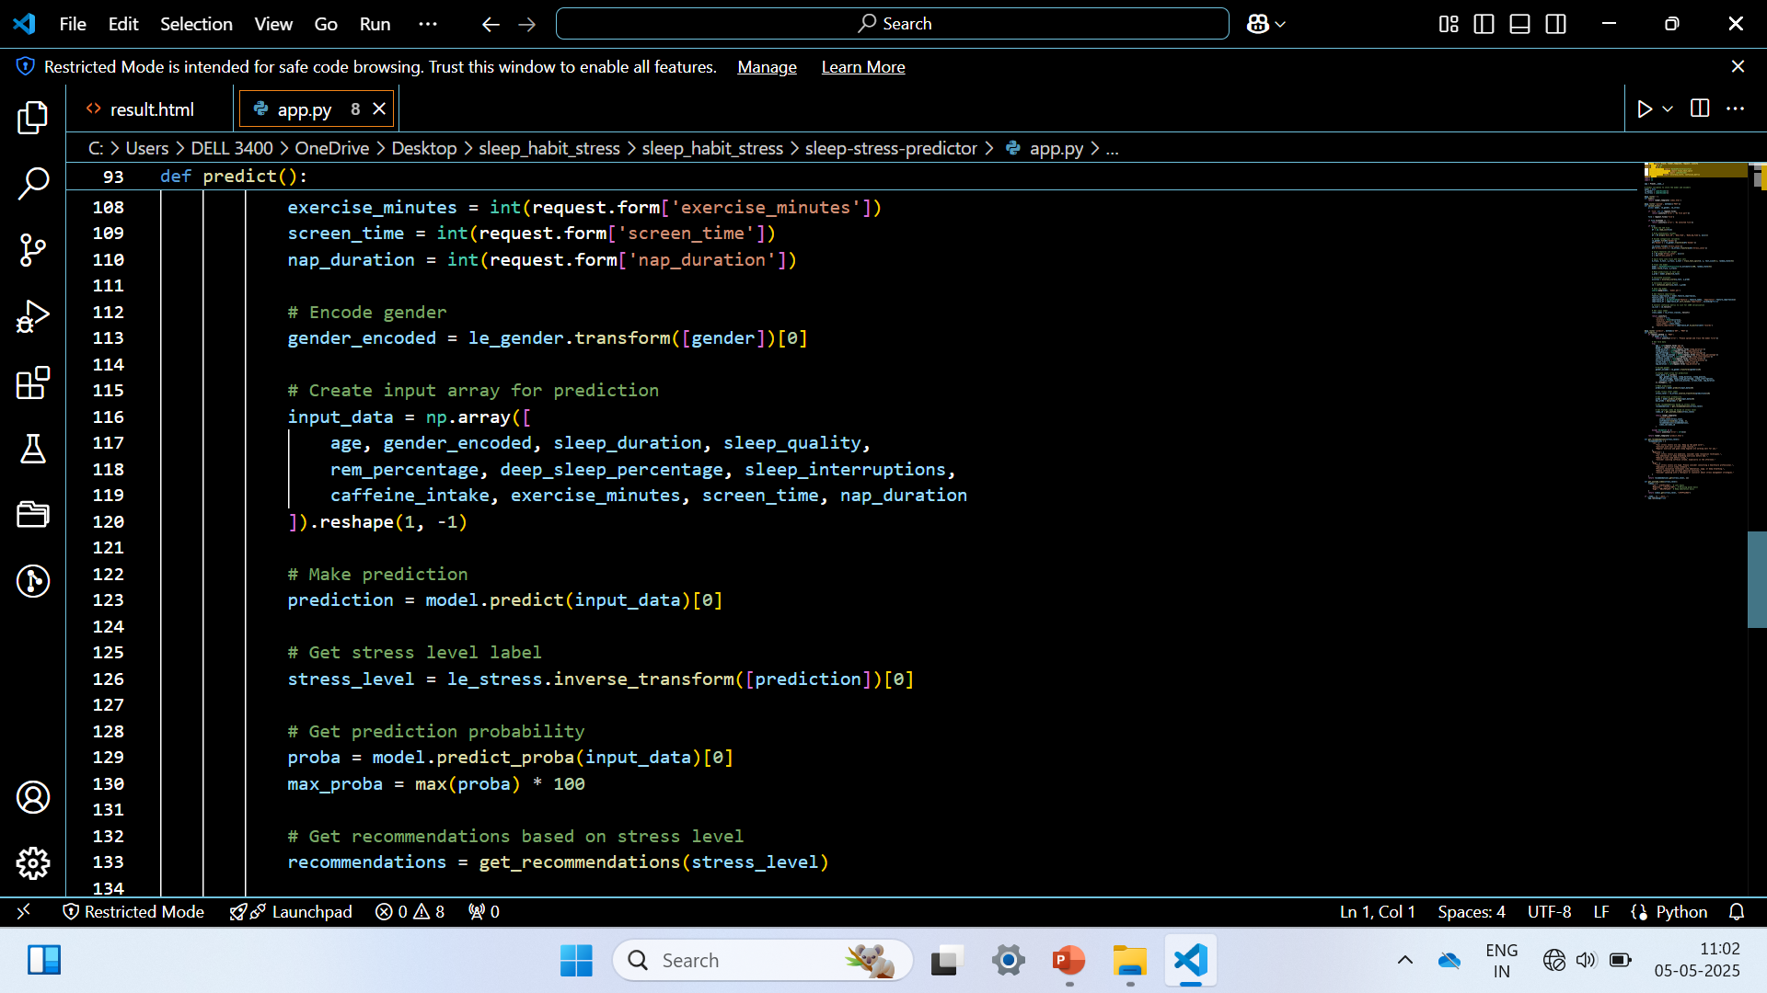
33

Slide 34
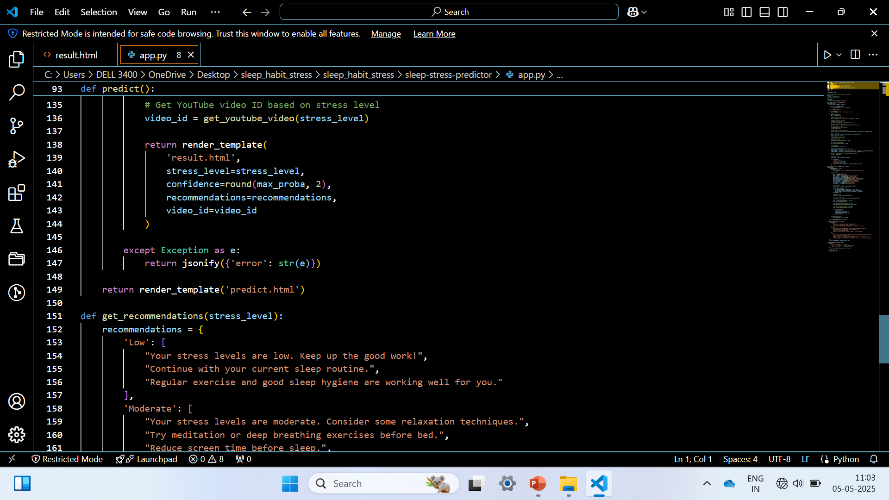
34

Slide 35
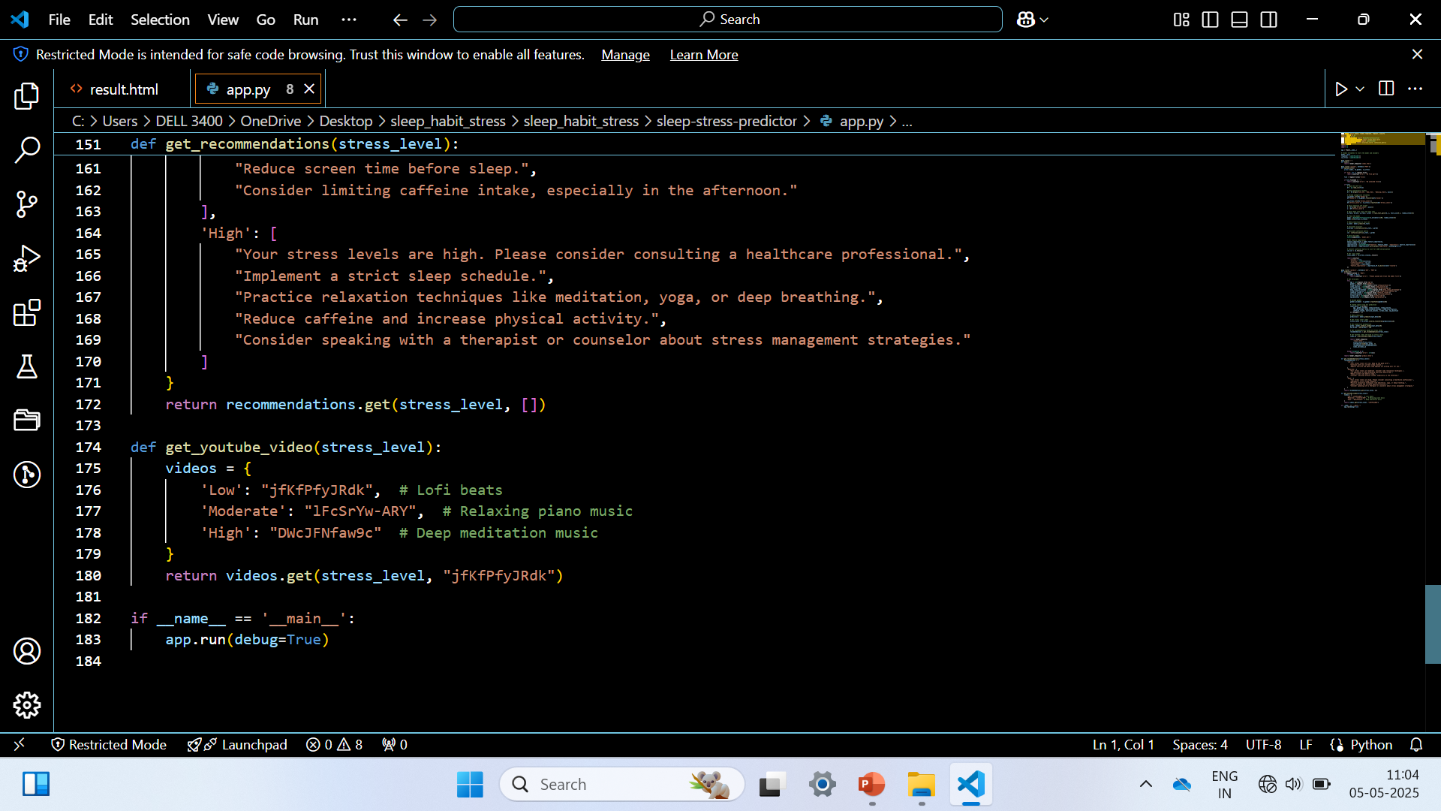
35

Slide 36
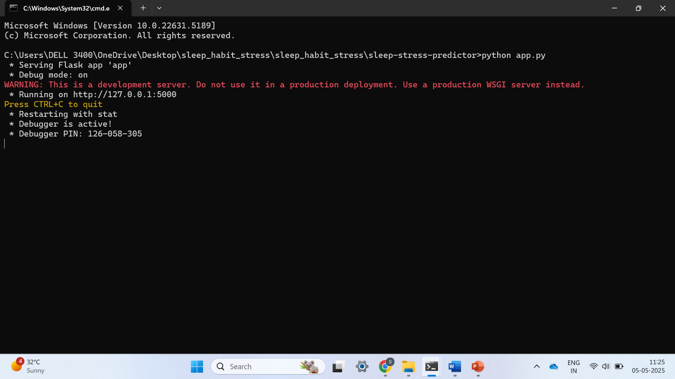
RESULT
36

Slide 37
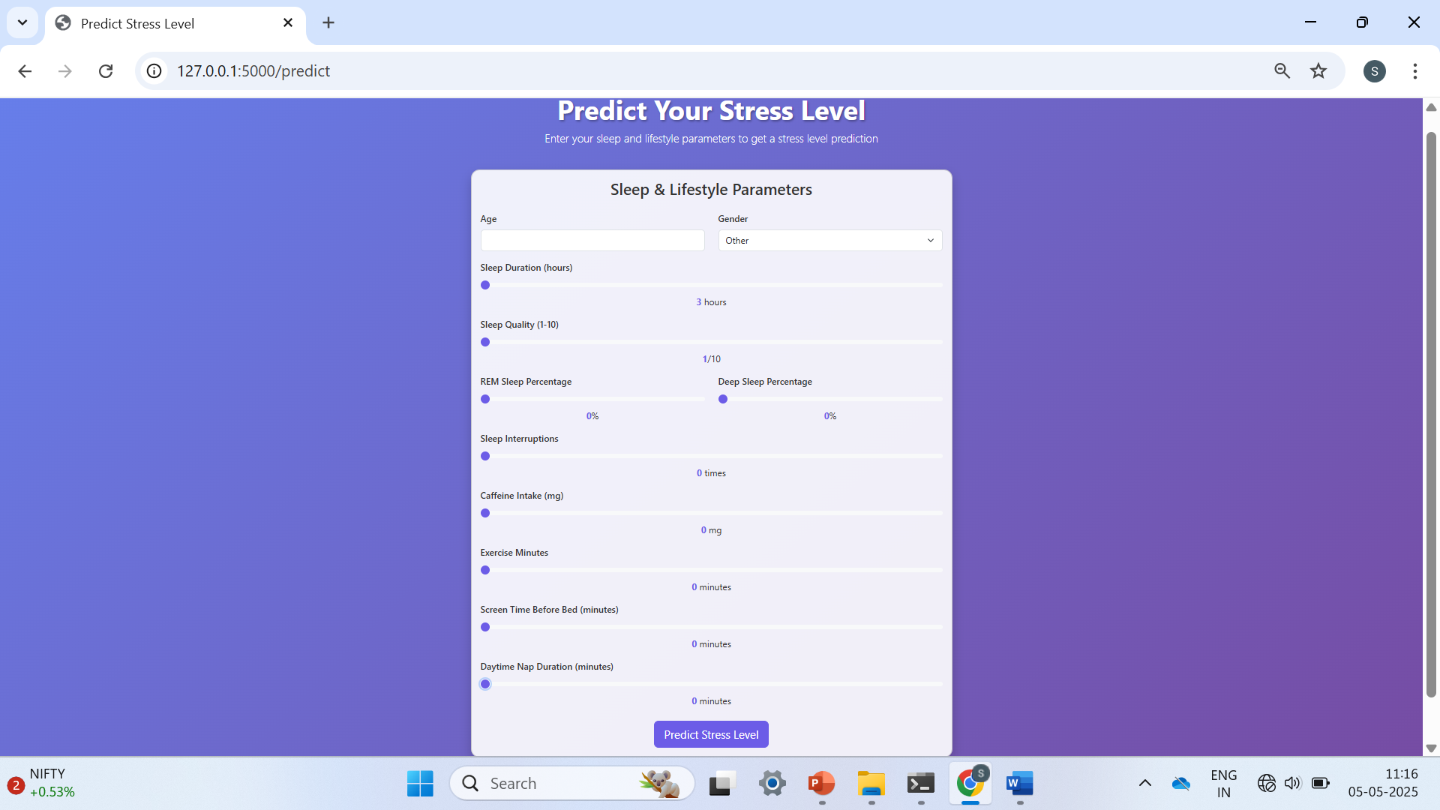
37

Slide 38
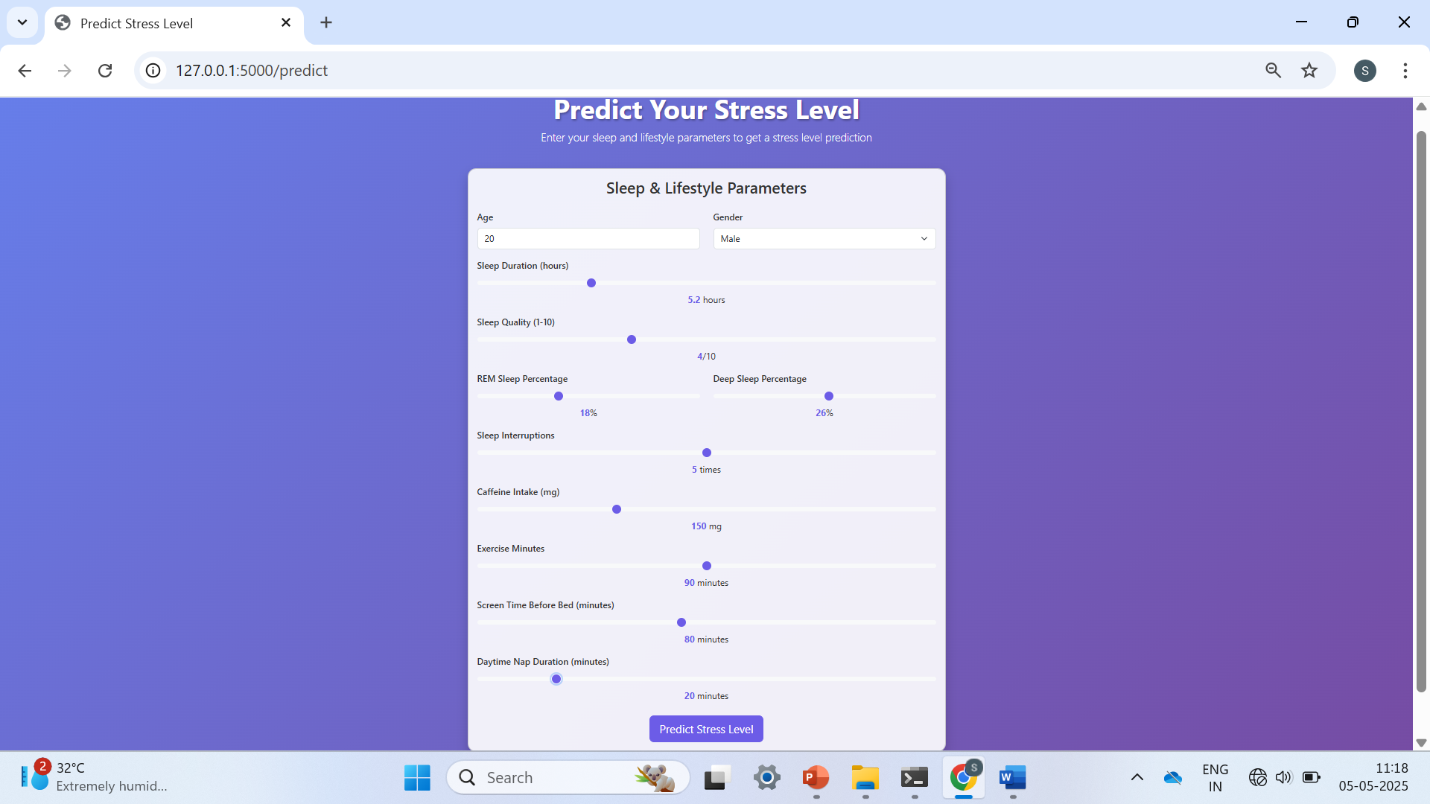
38

Slide 39
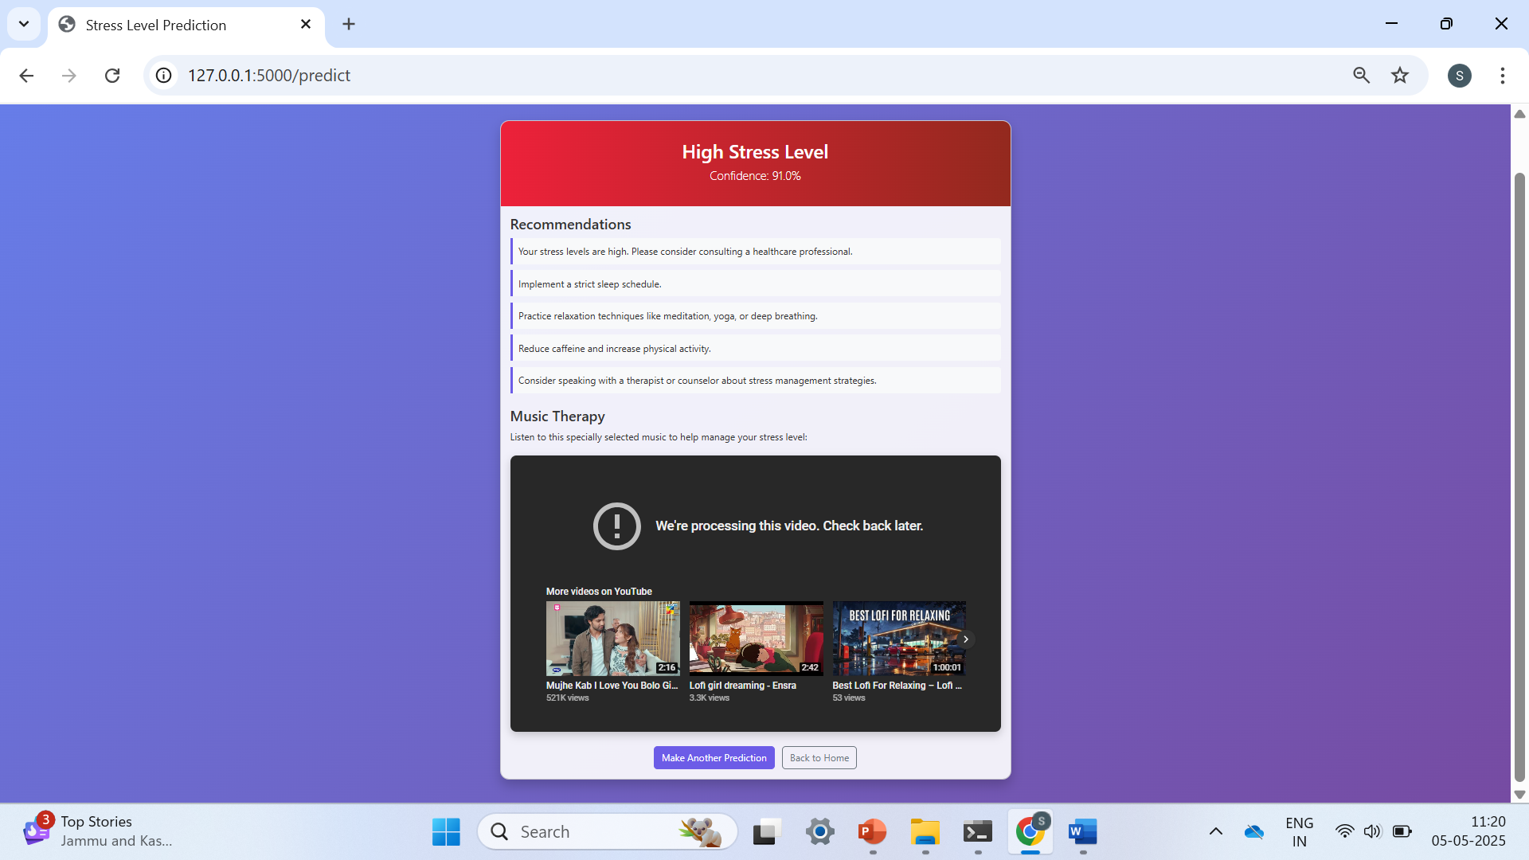
39

Slide 40
TESTING
Unit Testing
System Testing
White Box Testing
Black Box Testing
40

Slide 41
CONCLUSION
Designing a Human Stress Detection System based on sleep habits involves careful planning and testing, using sleep data and user input. By analyzing factors like sleep duration, quality, patterns, and movement, machine learning can help identify signs of stress. Although this technology offers a promising way to understand our well-being. Also, privacy and consent issues need to be considered to ensure responsible use of personal data. Despite these challenges, this approach has great potential for improving stress management and overall health.
41

Slide 42
LIMITATIONS
Data quality and Availability.
Individual Variability.
42

Slide 43
REFERENCES
Schneiderman, N., Ironson, G., & Siegel, S. D. (2005). Stress and health.
Vgontzas, A. N., Pejovic, S., & Karataraki, M. (2007). Sleep, Sleep Disorders, and Stress.
Bukhsh, Q., Shahzad, A., & Nisa, M. (2011). A study of learning stress and stress management strategies of the students of postgraduate level
Fink, G. (2017). Stress: Concepts, Cognition, Emotion, and Behavior: Handbook of Stress. Florey Institute of Neuroscience and Mental Health.
Shahsavarani, A. M., Abadi, E. A. M., & Kalkhoran, M. H. (2014).
43

Slide 44
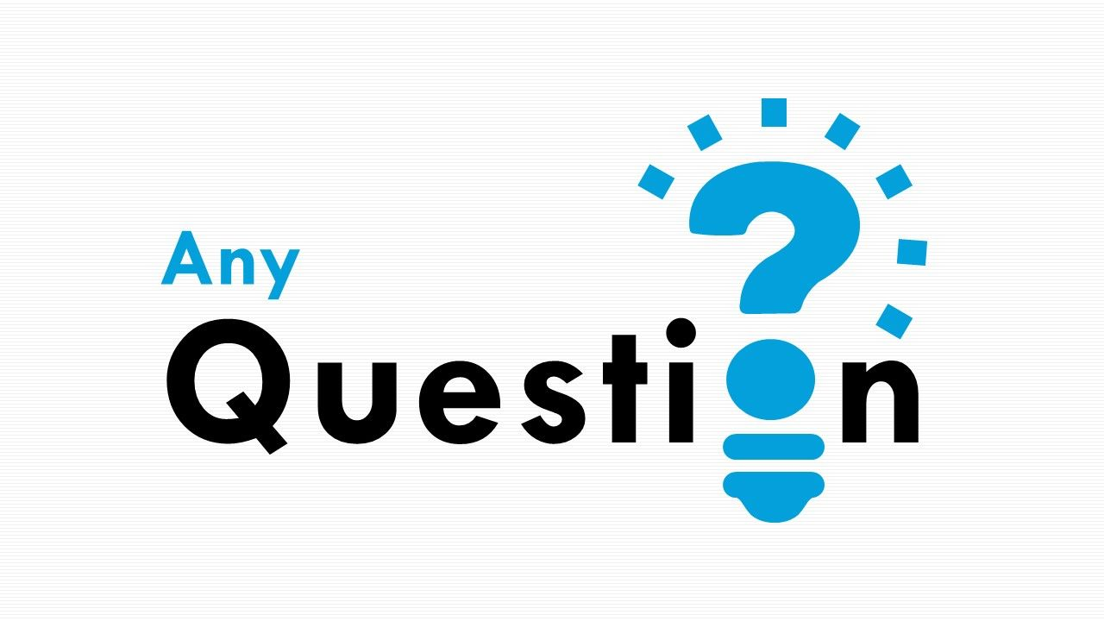
44

Slide 45

45

